Slide 1
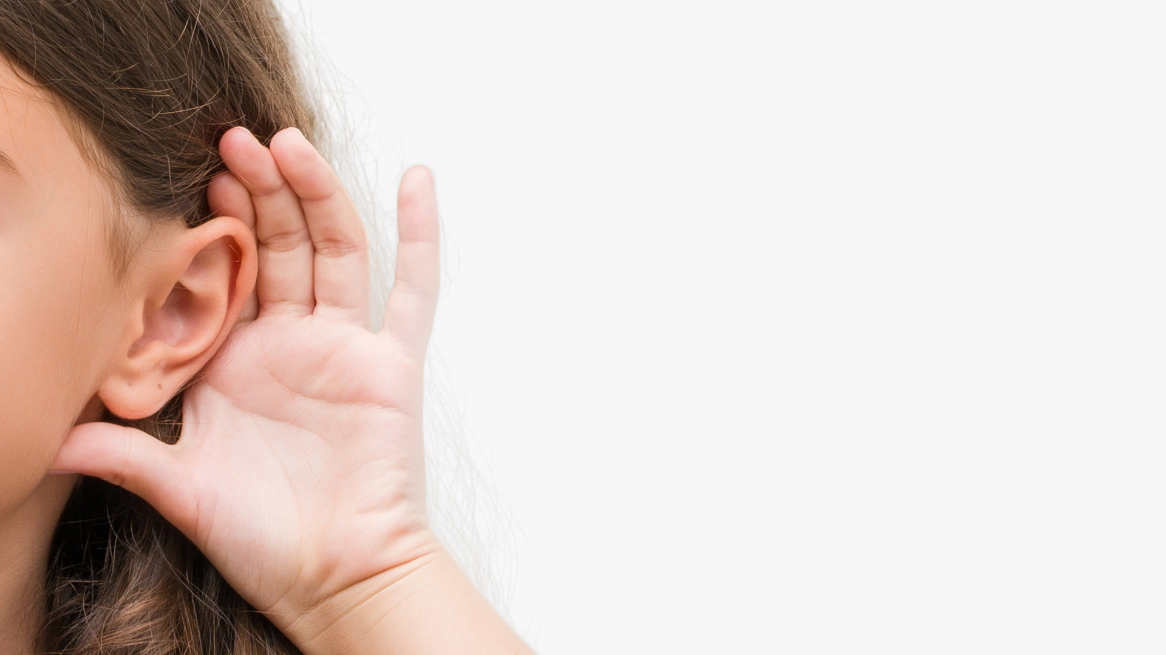

Hearing
and me

Slide 2
Introduction
Phonak is pleased to offer a presentation to help you talk about your hearing loss and hearing technology with your classmates.
It’s designed so that you can personalize it and make it your own. Add your own information and pictures - It’s meant to be as unique as you are!
We hope you find this template informative and fun.
*Instructions on how to upload images can be found within the presentation.

Slide 3
HOW TO ADD YOUR OWN IMAGE:
Right-click on the shape
Click on "Format shape".
In "Fill" select "Picture or texture fill"
Click on "File"
Select the desired image
In "Picture Tools", "Format", click on "Crop" and then "Fill"
My name is XXX
& I am XX years old
Insert your picture
I’d like to tell you about
my hearing and how
my hearing devices
help me hear some sounds
I couldn’t hear before

Slide 4
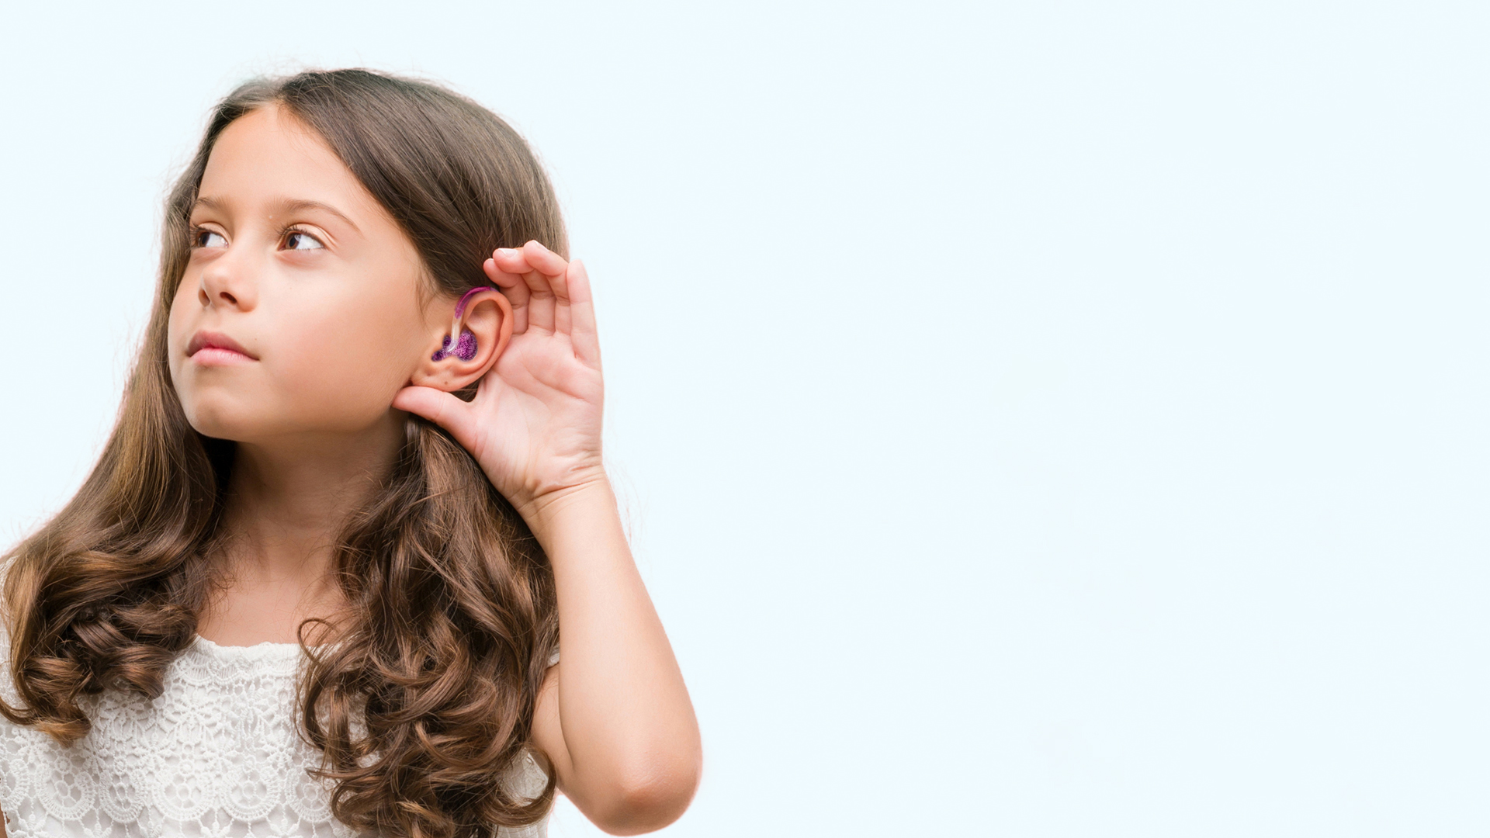

I don’t hear
all the sounds
like you do

Slide 5
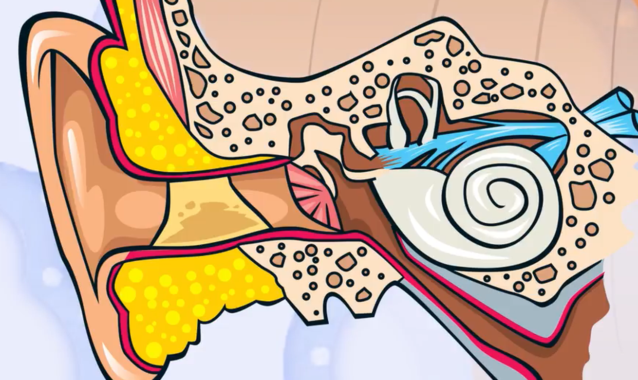





How we hear
inner ear
auditory nerve
to the brain
ear canal
ear drum
middle ear

Slide 6



How we hear
Here is a video
describing how
sounds make their
way to the brain
"Credit: Courtesy of the National Institutes of Health, Department of Health and Human Services".

Slide 7

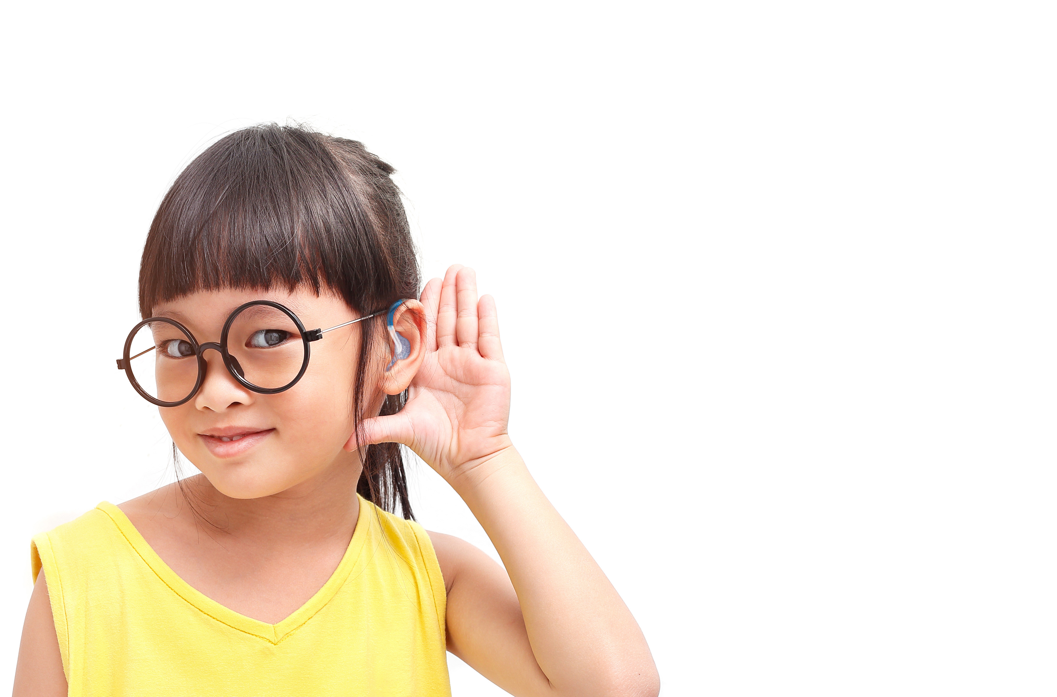

Hearing loss
Hearing loss
means difficulty
hearing
Some kids
are born with it
& others get it later on
Some hearing losses are temporary & some are permanent

Slide 8
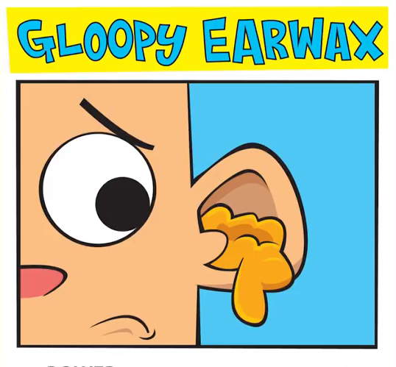

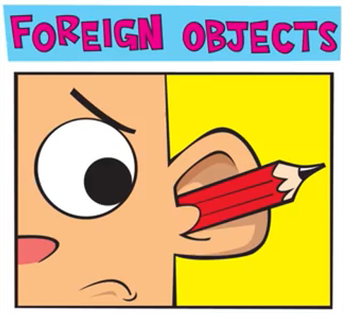
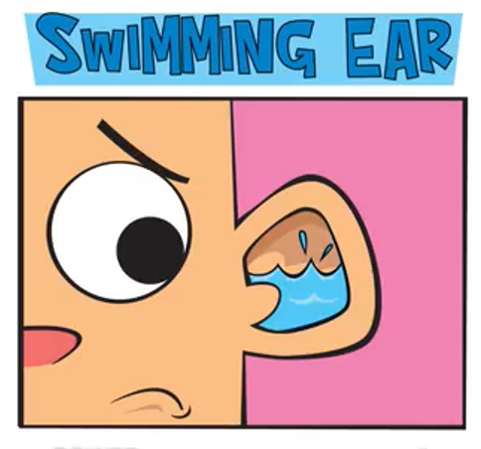

Types of hearing loss
Conductive
Sensorineural
A conductive hearing loss is caused
by anything that makes it difficult for sound waves to get through to the inner ear.
Some causes could be…
A sensorineural hearing loss
is caused by damage to the inner ear
or the pathways to the brain
This can occur before
or after birth
Wax blocking
the ear canal
A hole in
the ear drum
Something stuck
in your ear
Fluid in the
middle ear space
due to an infection

Slide 9
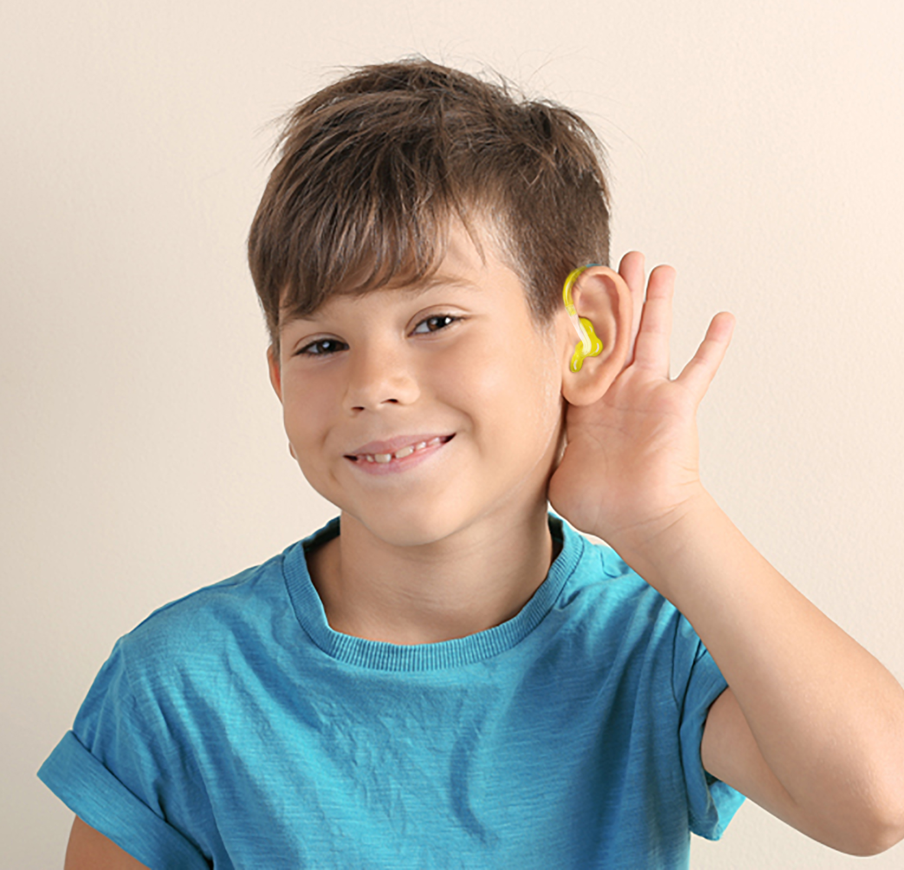
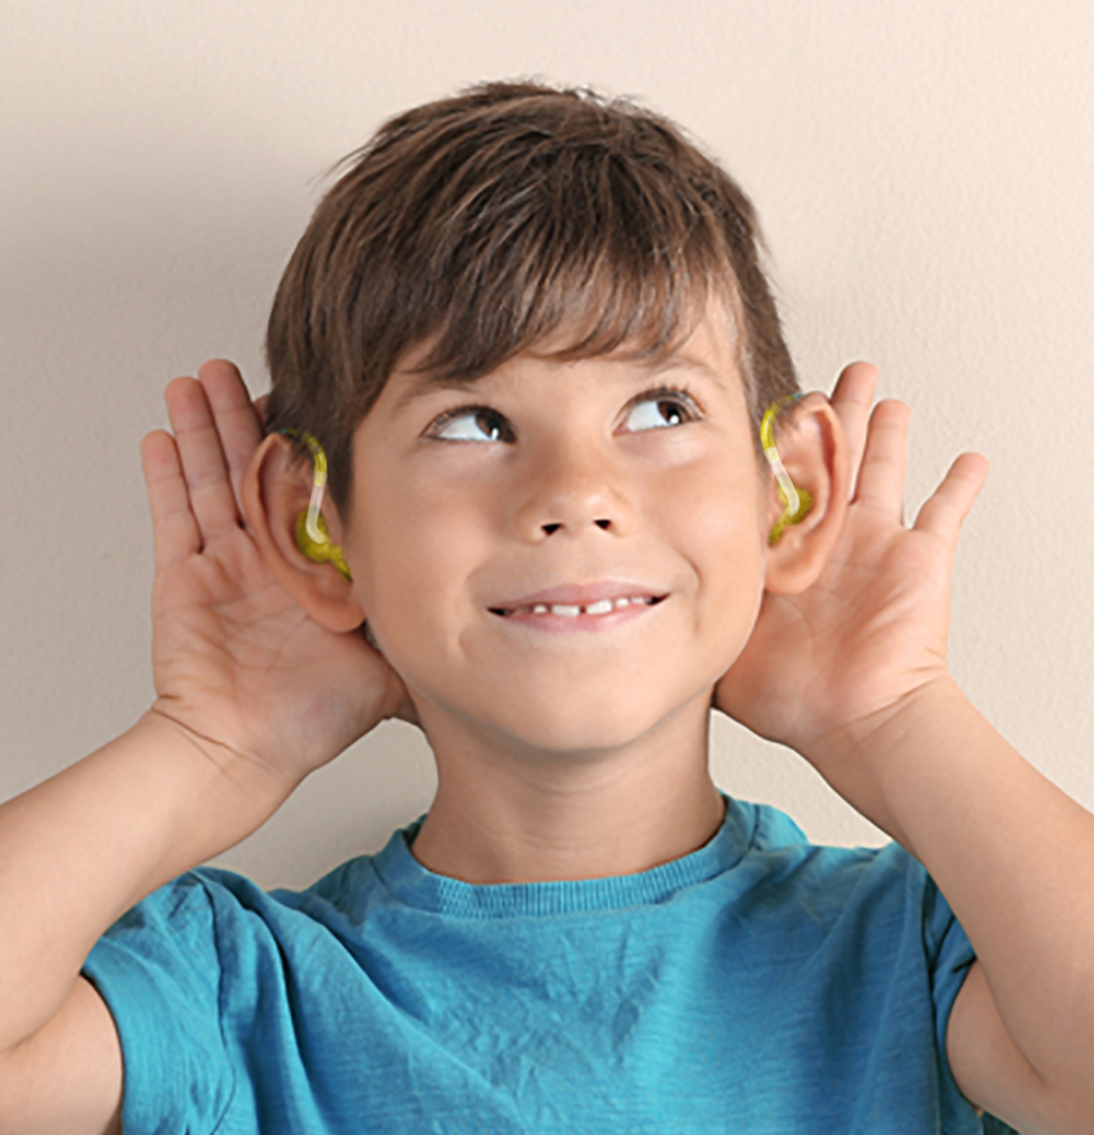
Types of hearing loss
Unilateral
Bilateral
Unilateral hearing
loss means hearing
loss in one ear
Bilateral hearing
loss means hearing
loss in both ears

Slide 10
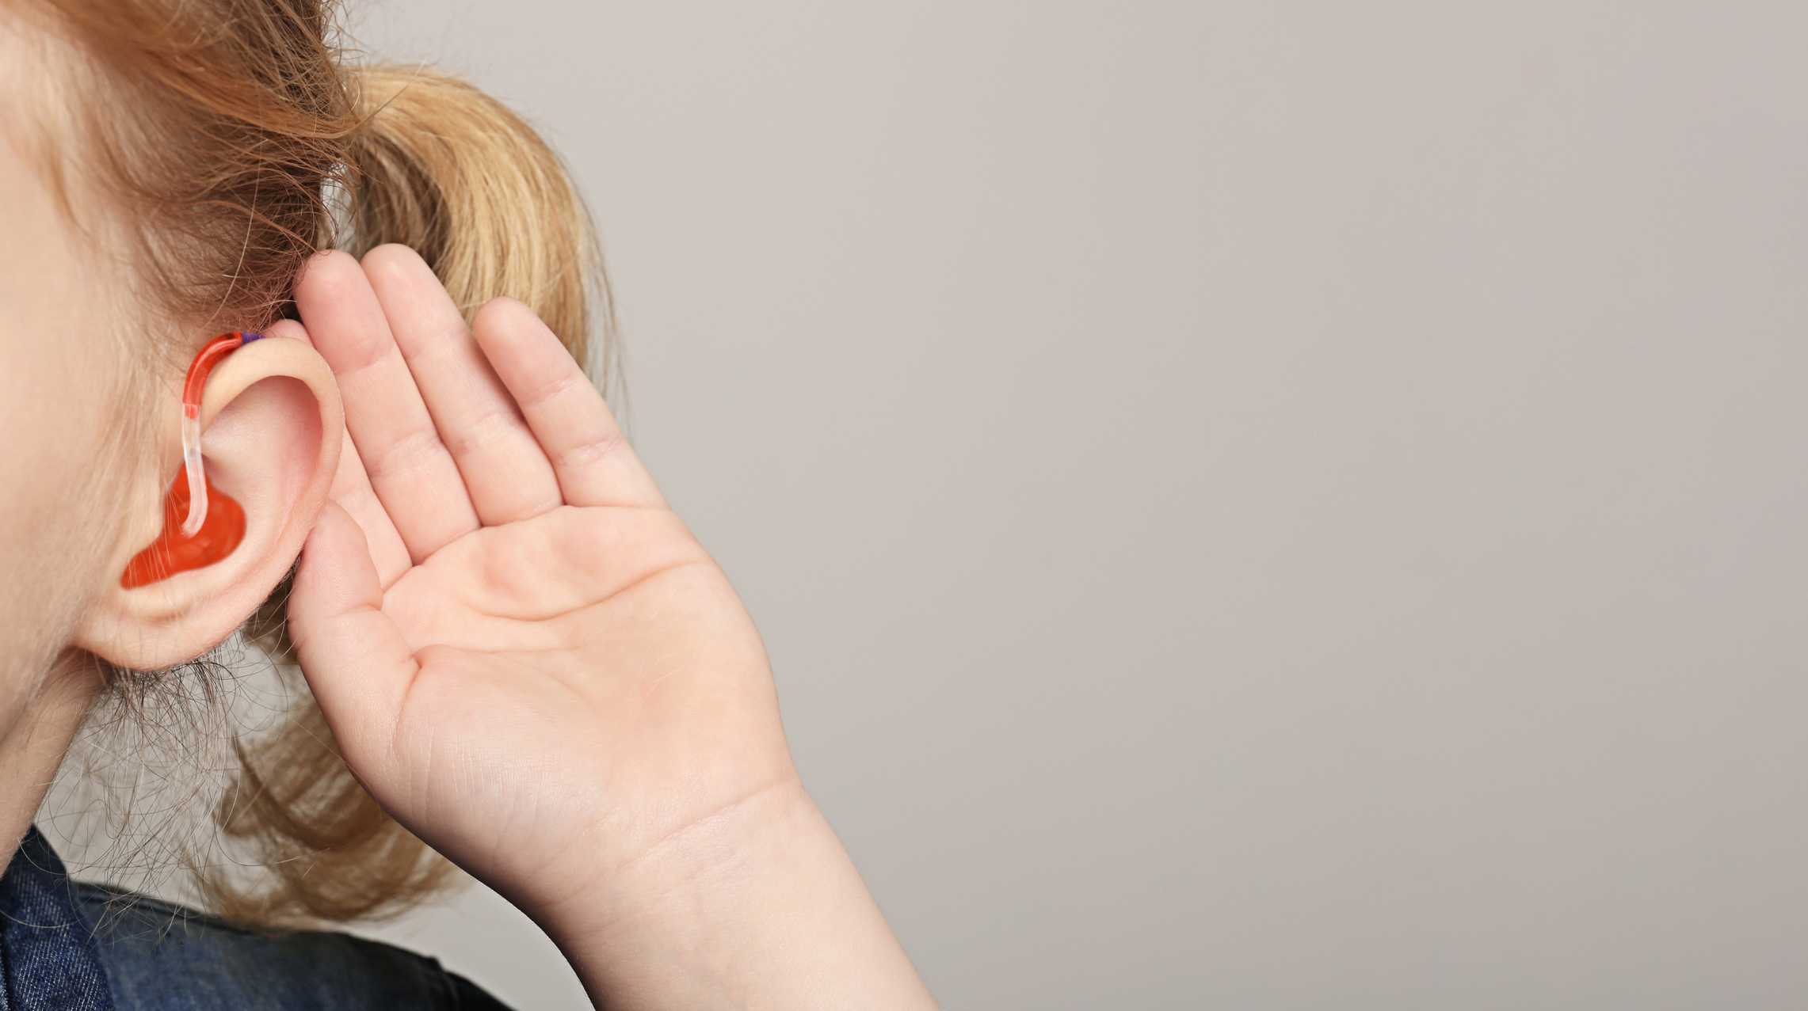
My hearing
loss is
Conductive

Slide 11

My hearing
loss is
Sensorineural

Slide 12
My hearing
loss is
Unilateral

Slide 13
My hearing
loss is
Bilateral

Slide 14










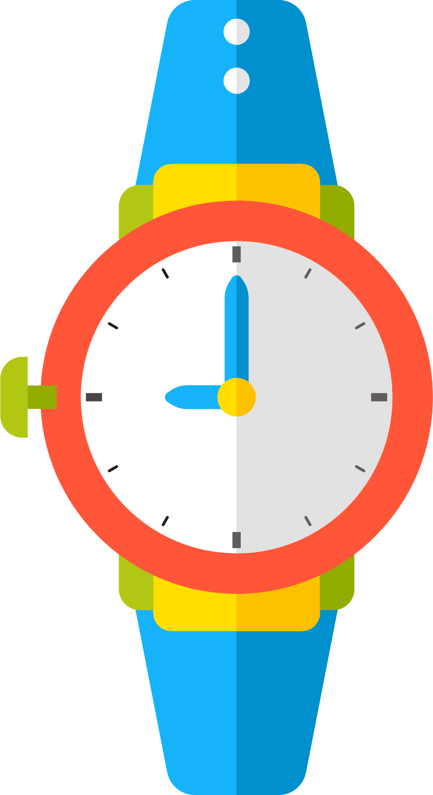



I found out I had a hearing loss when I had a hearing test
You can see this in a graph called an audiogram
Loudness
measured in decibels (dB HL)
120
100
80
60
P CH SH H K
A O R
40
L NG NM
J ZG
IU
VBD
F
TH S
20
Pitch or frequency
measured in cycles
per second (Hz)
0
125
250
500
1 000
2 000
4 000

Slide 15

HOW TO ADD YOUR OWN AUDIOGRAM:
Take a picture of your audiogram and save it onto your computer.
Go to “Insert image” and upload it.
My audiogram
Insert your audiogram

Slide 16





My 3 favorite sounds are
1
XXX
Bloop
Driiiing
2
XXX
3
XXX
Splash
What are your favorite sounds?

Slide 17
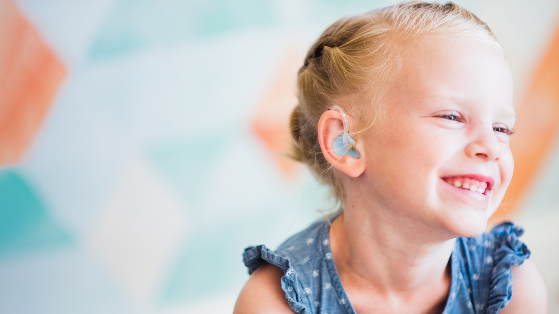
My hearing
Just like wearing
glasses helps some
people see, hearing aids
help me hear

Slide 18

I call the day
I got my hearing aids, my
“Hearing birthday”
My hearing birthday is
XXX

Slide 19

HOW TO ADD YOUR OWN IMAGE:
Right-click on the shape
Click on "Format shape".
In "Fill" select "Picture or texture fill"
Click on "File"
Select the desired image
In "Picture Tools", "Format", click on "Crop" and then "Fill"
Insert image of your hearing aid(s)
A hearing aid
is a small electronic
device that I wear
behind my ear

Slide 20
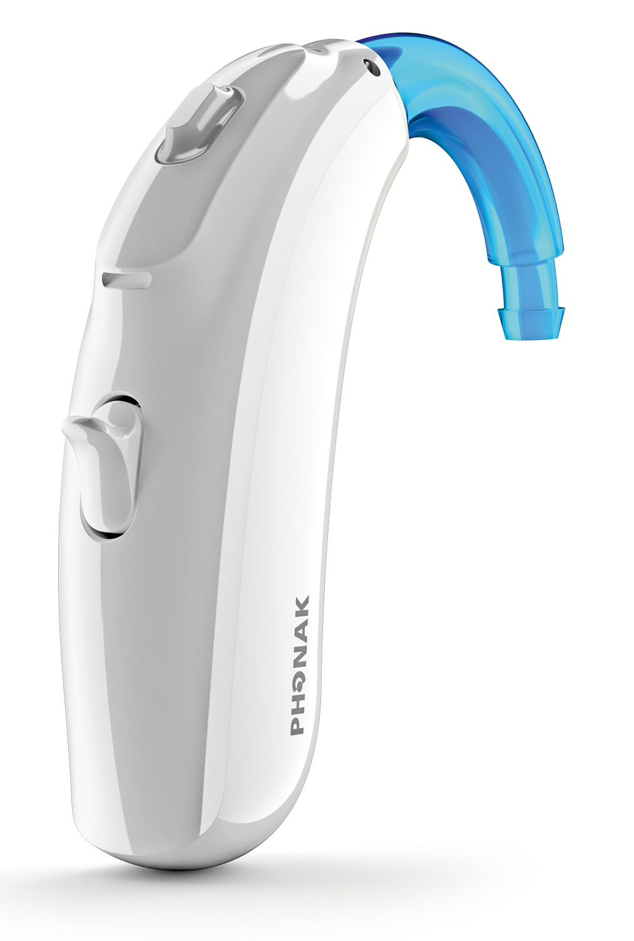
1
microphone
1
3
amplifier
1
2
2
speaker
3
A hearing aid has
Three basic parts

Slide 21

Hearing aids are filled with
amazing technology
They also help me
hear better
in noisy places
How hearing
aids work
They can make soft sounds louder
without making loud sounds too loud

Slide 22
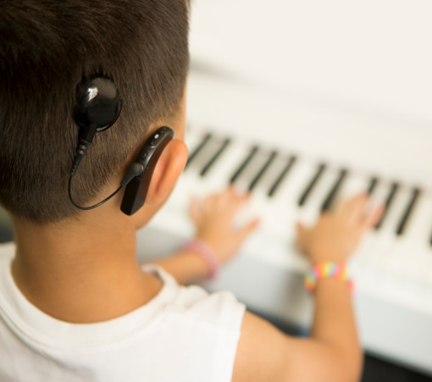


Cochlear
Implants
A cochlear implant
is an electronic device for people
with severe to profound
hearing loss

Slide 23
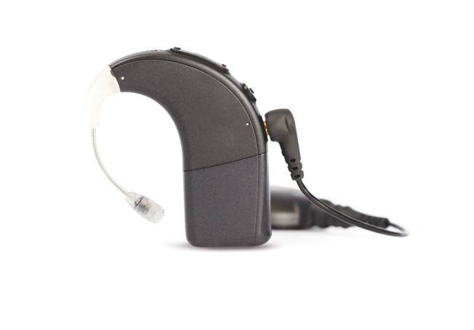
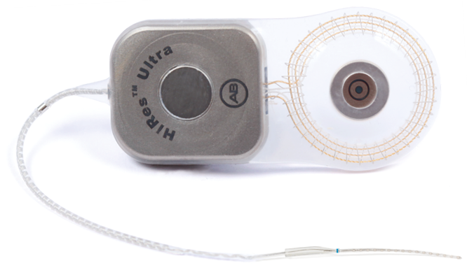
A cochlear implant has
two main parts
1
2
sound processor
internal receiver
The sound processor
is worn like a hearing aid
The internal receiver is implanted
under the skin behind the ear

Slide 24

Cochlear implants are also filled with amazing technology
Instead of making
sounds louder like
a hearing aid, the cochlear implant turns sounds
into electrical signals
& provides a sensation
of hearing by stimulating
the auditory nerve

Slide 25
HOW TO ADD YOUR OWN IMAGE:
Right-click on the shape
Click on "Format shape".
In "Fill" select "Picture or texture fill"
Click on "File"
Select the desired image
In "Picture Tools", "Format", click on "Crop" and then "Fill"
Roger™ also helps me
when it’s noisy, when the teacher is far away or when it’s echoey
1
The teacher wears
a special microphone
Insert image of your Roger device
2
The microphone picks up their voice
& sends the sound to my ears
The microphone makes it so I can hear as if the teacher is right next
to me
3

Slide 26





My hearing loss doesn’t change
my personality or make me
different from everyone else
When someone wears
hearing aids, you don’t need to
speak like this!

Slide 27

Here are some tips that will
help me hear you
If I don’t hear you,
tap me on the shoulder
to get my attention
When you talk to me,
make sure I can
see your mouth
Move away
from noisy places

Slide 28


Speak
clearly
If I don’t hear you,
try saying it in a
different way
Do not shout
or move
your lips more than
you usually do

Slide 29


You hear sounds even
When you sleep
Fish don’t have ears...
but you do!

Slide 30

Even if you don’t have a hearing loss, it is important
to protect your hearing
Noise can be too loud
during many activities
Easy tips
to protect your hearing!
1
Listening to music
at high volumes
1
Lower the volume
2
Playing with loud toys
2
Move away from the noise
If someone sitting next to you
can hear your music it is too loud!

Slide 31
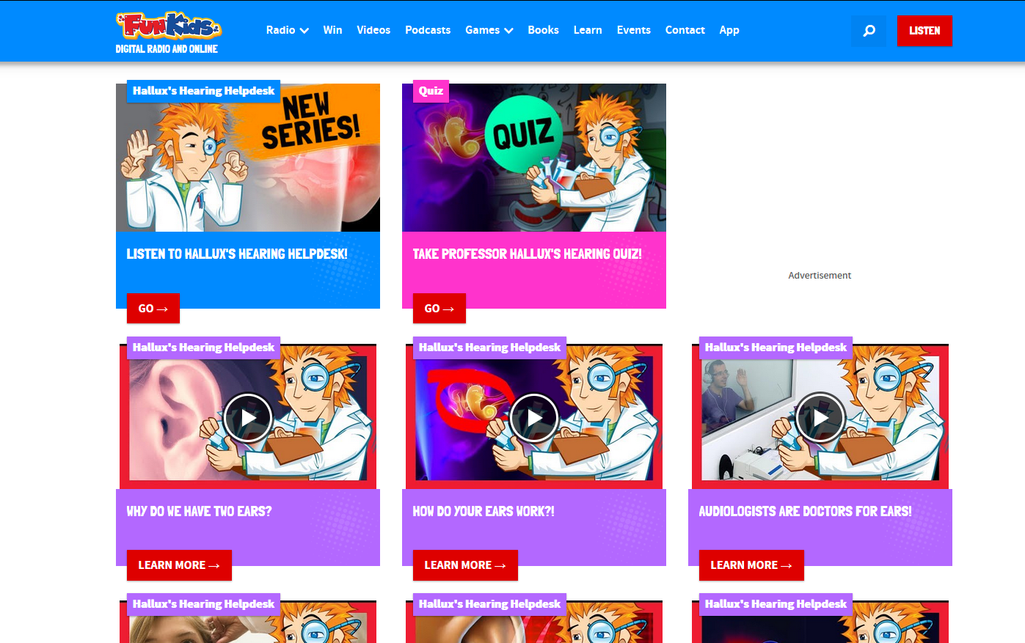

Learn more about
Hearing
& our ears

Slide 32
Questions?

